Slide 1
Agency Prepayment Model: Curtailment
February 2016

Slide 2
Outline
Introduction to Curtailment
Description of Data
Empirical Observations and Comparisons
Description of Framework
Results
Spline Results
Final Fixed-rate 30-Year Curtailment Vector

Slide 3
Introduction to Curtailment
Standard Curtailment Definition:
Principal reduction that is greater than the standard amortization schedule for that period
Does not include Defaults, Turnover or Refinances
Identifying Curtailments:
Curtailments are not explicitly identified in any data source (eMBS Loan Level data or GSE Loan Level data)
Other prepayment types (voluntary vs involuntary) are identified with a flag (GSE LL data) but not in eMBS data
Research Curtailment Definition:
Use Standard Definition while excluding anything where the balance is reduced to zero
This has the drawback that we are excluding full payoffs
It has the benefit of separating curtailments from Defaults, Turnover and Refinances (as they reduce the balance to 0)
Empirical Formulas for identifying Curtailments:
GSE: abs(balance difference between two months + scheduled principal pmt < 0)
eMBS: 1 – current balance / scheduled amortization balance

Slide 4
Description of Data
GSE Loan Level data
~ 40 M loans with data as far back as 1999
Loan Age up to 180 months
Has indicators for Prepayment (voluntary) and Default (involuntary)
Citi data: Table of data from a 1997 paper by Qiang Fu
~ 25 K loans from Citicorp Mortgage, Inc. (all 30-Year Fixed-rate)
Origination years from 1967-1995 and observed curtailments over a period of 21 months
This serves as our reference for late maturity curtailments which can be significant
eMBS Loan Level data
~ 35 M loans with data as far back as 2006
Loan Age up to 360 months (sparse data for very seasoned loans)
eMBS Pool data
~ 800 K pools with data as far back as 1994
Loan Age up to 360 months (less sparse than loan level data)

Slide 5
Empirical Observations (GSE Loan Level Data)
Curtailment
Occurs ~ 9 times in the life of a loan
Average Curtailment amount is ~ $3,100
 | Loan Count | Avg Balance | Count Curtailment | Amount Curtailment | Avg # Curtailment | % Bal Curtailment | Avg Curtail Amount
Total | 15,563,076 | 115,336 | 135,717,582 | 48,366,768,722 | 8.7 | 0.2% | $ 3,108
WALA (Year) | Loan Count | Avg Balance | Count Curtailment | Amount Curtailment | % Curtailment | % Bal Curtailment | Avg Curtail Amount
1 | 15,664,852 | 176,093 | 15,750,700 | 6,676,899,030 | 21.0% | 0.242% | $ 2,029
2 | 14,194,272 | 169,632 | 31,843,233 | 11,970,215,809 | 21.6% | 0.497% | $ 3,906
3 | 10,402,492 | 162,021 | 24,164,141 | 8,782,407,996 | 22.0% | 0.521% | $ 3,831
4 | 7,883,737 | 154,810 | 18,413,614 | 6,222,090,684 | 22.3% | 0.510% | $ 3,541
5 | 5,844,150 | 147,804 | 13,718,693 | 4,473,243,048 | 22.4% | 0.518% | $ 3,414
6 | 4,252,594 | 139,520 | 10,197,011 | 3,230,010,612 | 22.5% | 0.544% | $ 3,382
7 | 3,263,579 | 132,014 | 7,714,931 | 2,520,913,937 | 22.6% | 0.585% | $ 3,419
8 | 2,380,627 | 122,951 | 5,523,412 | 1,830,669,331 | 22.7% | 0.625% | $ 3,395
9 | 1,671,904 | 113,144 | 3,778,787 | 1,229,958,493 | 22.7% | 0.650% | $ 3,236
10 | 1,069,439 | 102,567 | 2,372,588 | 768,831,834 | 22.7% | 0.701% | $ 3,170
11 | 647,065 | 92,112 | 1,303,343 | 399,174,393 | 22.8% | 0.670% | $ 2,707
12 | 275,059 | 77,348 | 516,412 | 145,361,073 | 22.6% | 0.683% | $ 2,344
13 | 126,231 | 69,468 | 235,275 | 64,614,703 | 22.5% | 0.737% | $ 2,274
14 | 53,508 | 64,271 | 118,193 | 33,007,555 | 22.7% | 0.960% | $ 2,722
15 | 34,007 | 61,761 | 66,233 | 19,120,571 | 22.7% | 0.910% | $ 2,479
16 | 4,452 | 59,866 | 1,016 | 249,652 | 22.8% | 0.094% | $ 246

Slide 6
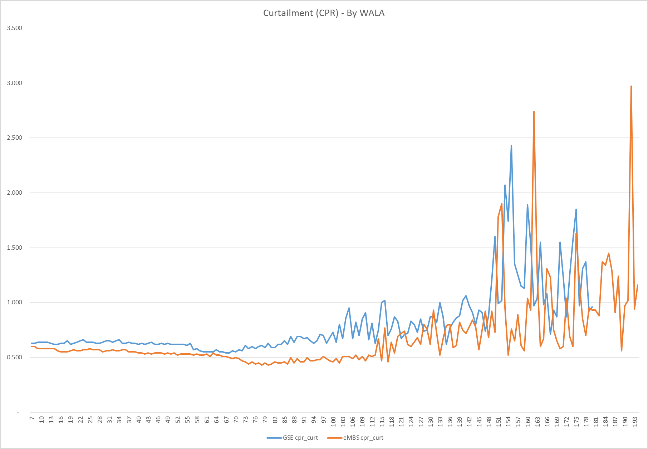
Empirical Observations II
Calculating Curtailments (GSE, eMBS):
Using a matching algorithm we pulled 6.5 million loans from the GSE and eMBS loan level data tables
Using different calculation methods we demonstrate that the observed curtailments are comparable between the two sources
CPR
GSE data is Freddie data only as the matching algorithm is much more robust

Slide 7
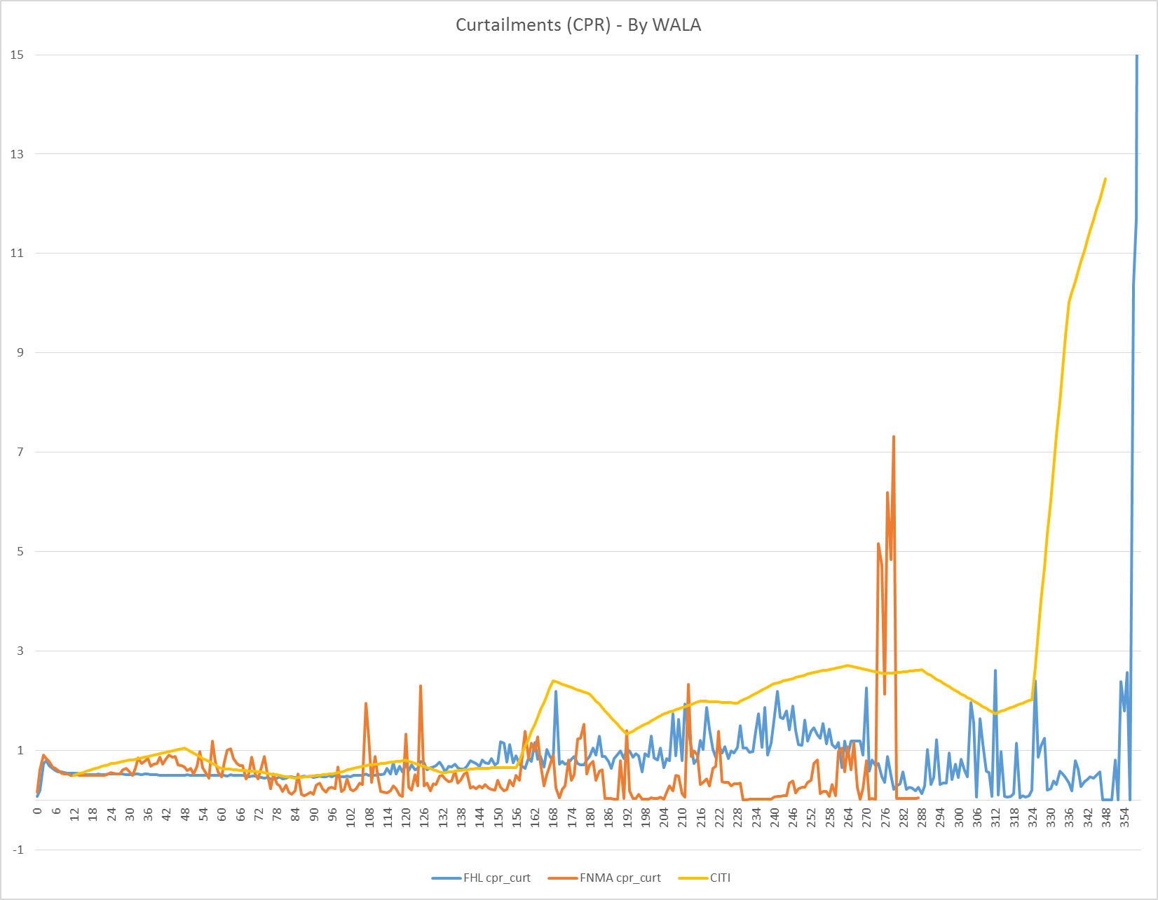
Empirical Observations III
Observations from the Data (Citi, GSE LL, eMBS):
Curtailments are very low and stable for the first 12-15 years of the life of the loans
The next 10-15 years are still stable, but curtailments become more significant @1-2 CPR
The last 3 years sees a sharp increase in curtailments as the borrowers seek to eliminate debt
CPR
The eMBS data is sparse after WALA > 250

Slide 8
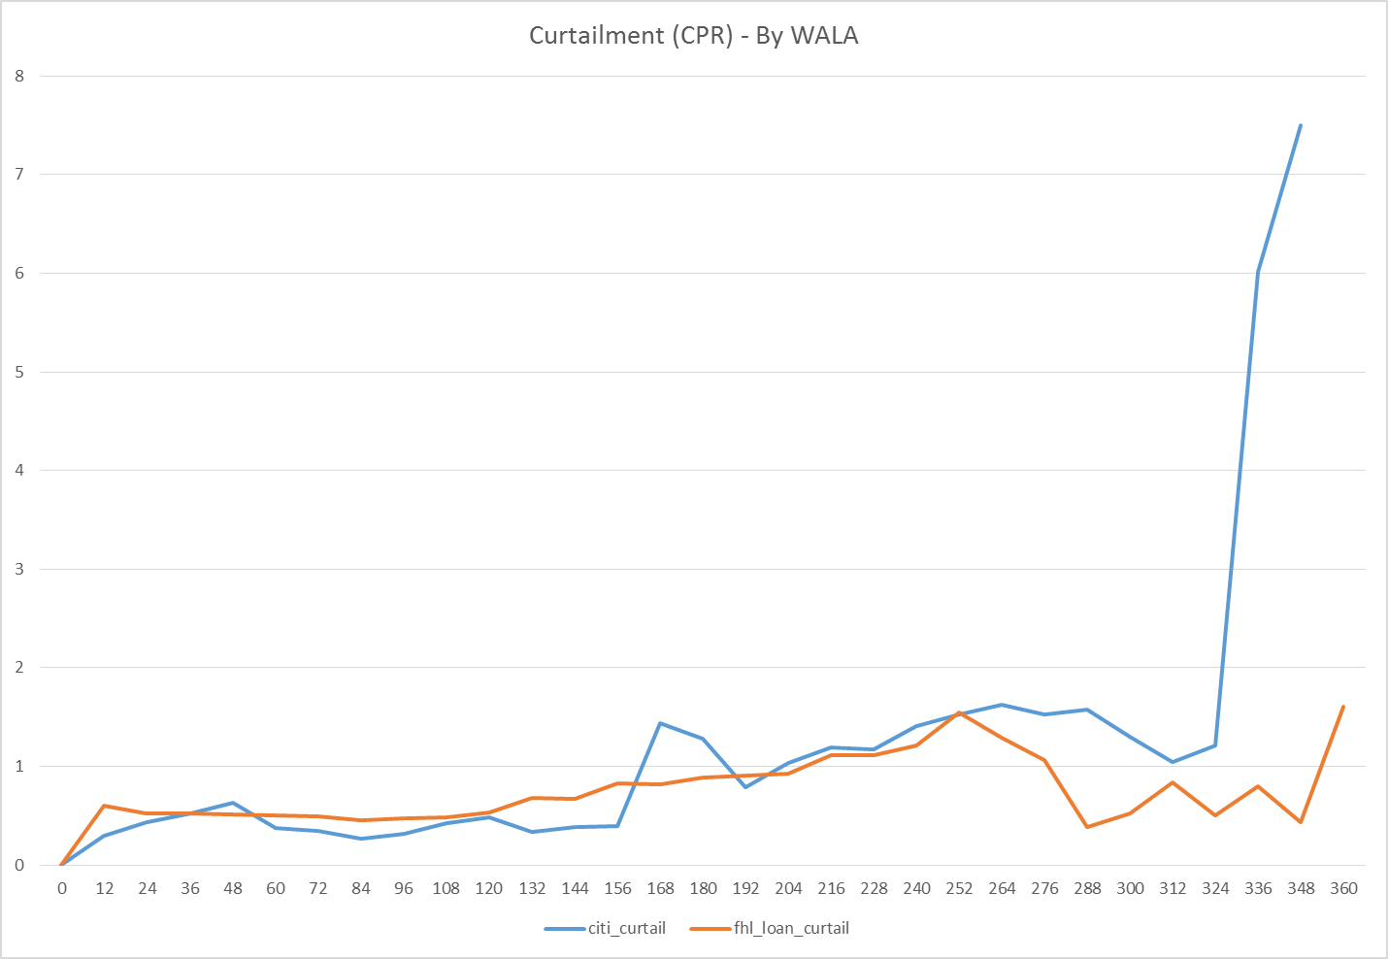
Empirical Observations IV
FHLMC eMBS data vs Citi data
Freddie data has loan ages up to 360 months, so we use that data to calculate curtailments
The data is very sparse for the high WALA loans
Hence we group the data into Yearly Loan Age buckets
This is easily comparable with the Citi data
CPR

Slide 9
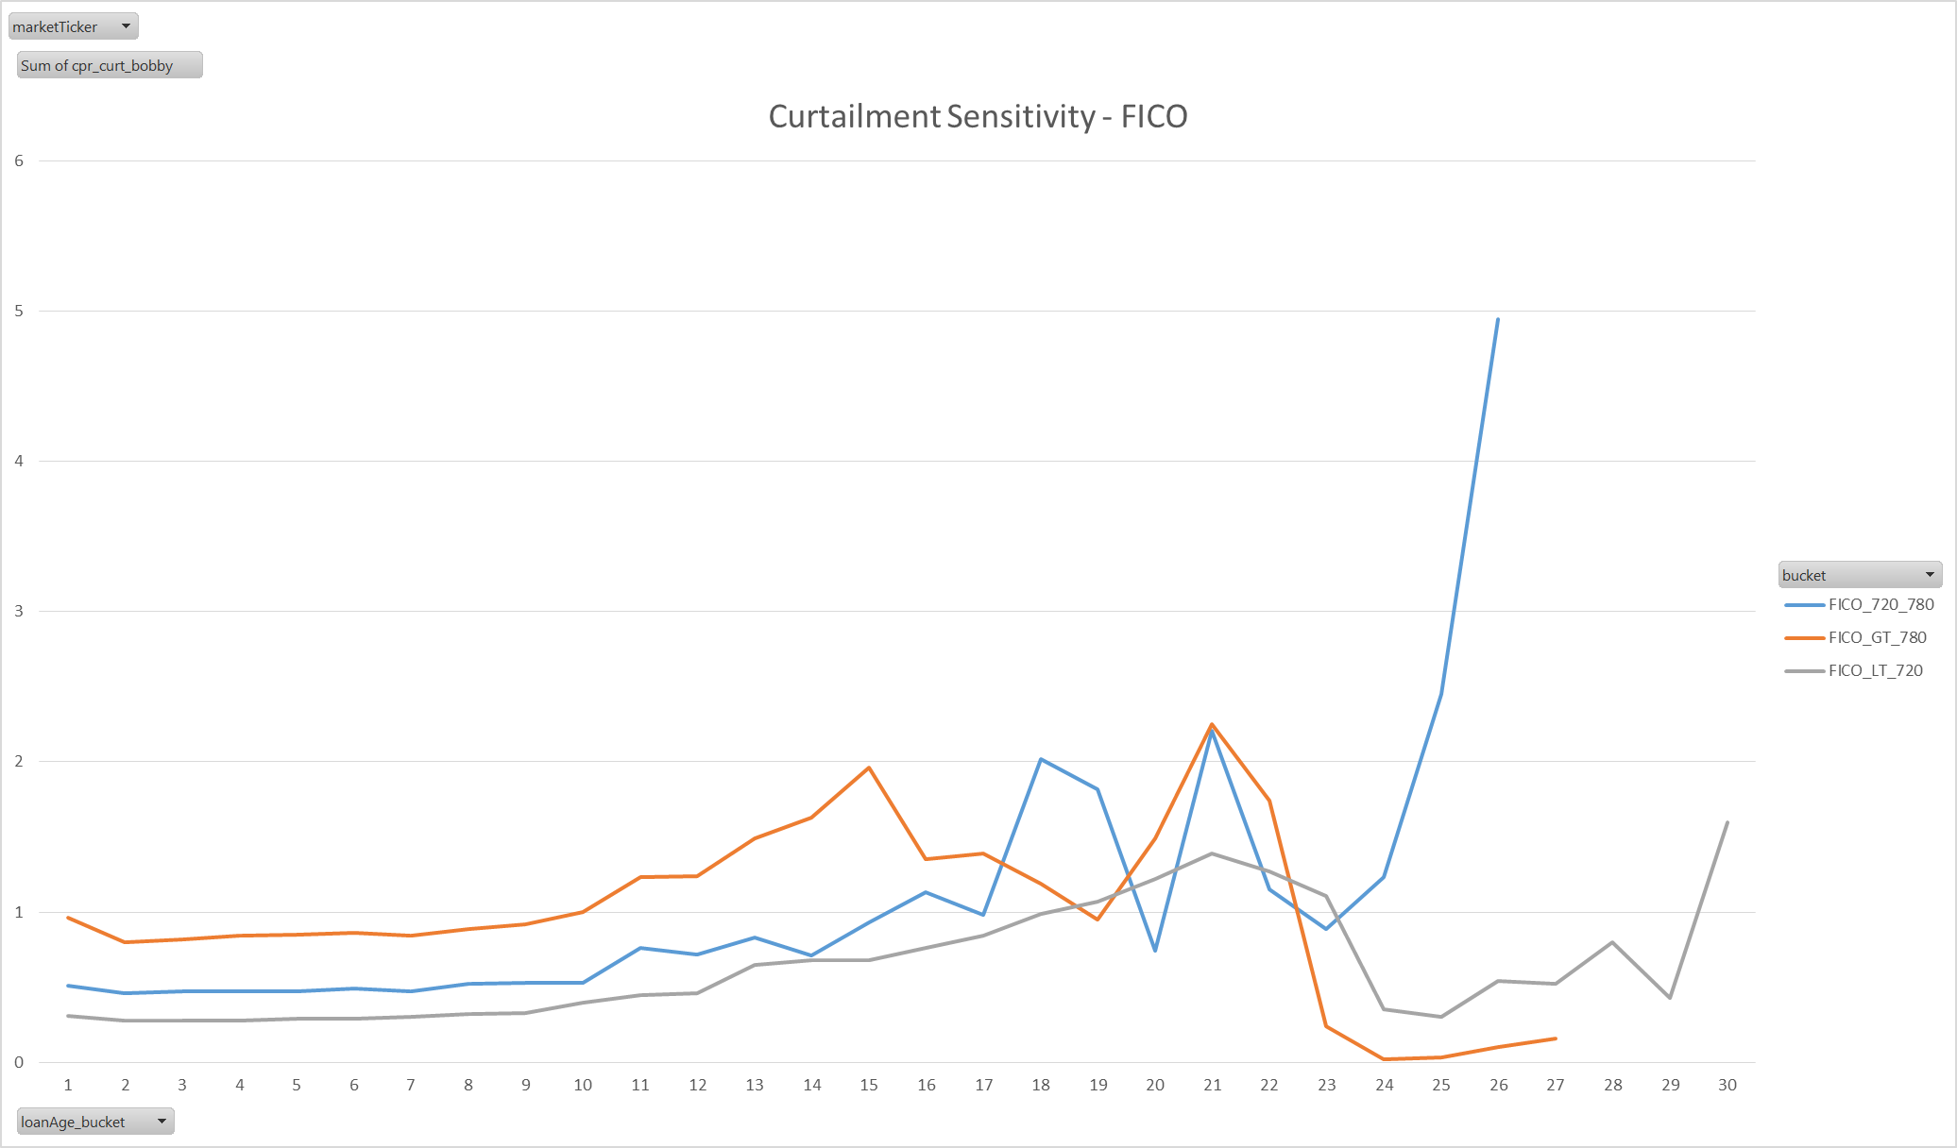
Empirical Observations V
Sensitivity of Curtailment to Collateral Attributes
Curtailments show dependence on FICO and LTV, DTI and Loan Size effects are less visible
The sensitivity only seems significant for the first 10-15 years the loan (WALA <= 180 months)
CPR

Slide 10
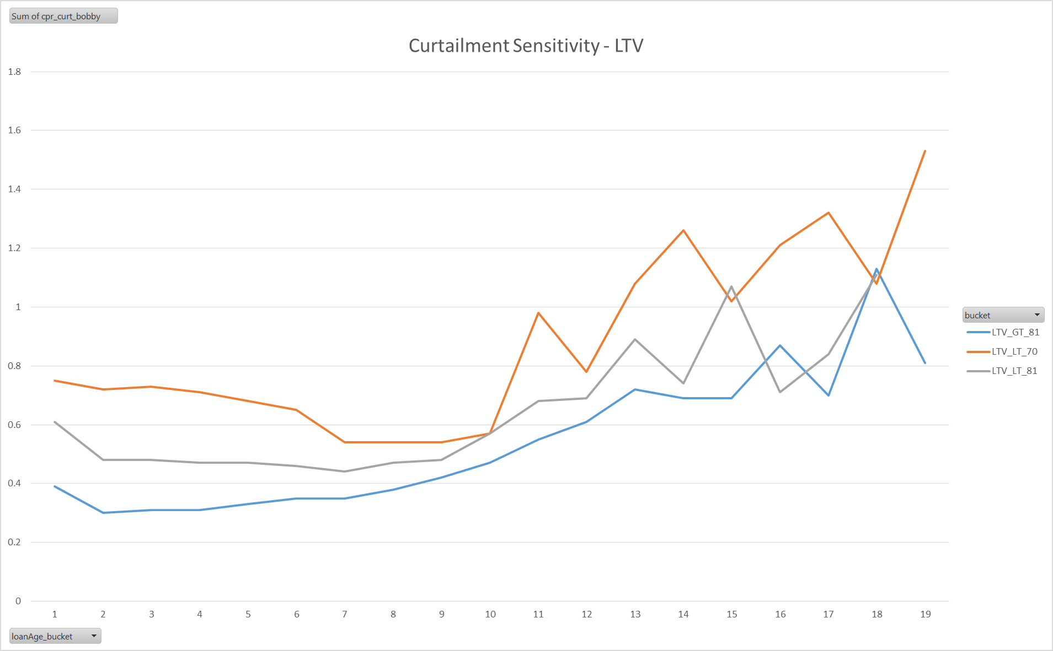
Empirical Observations VI
CPR

Slide 11
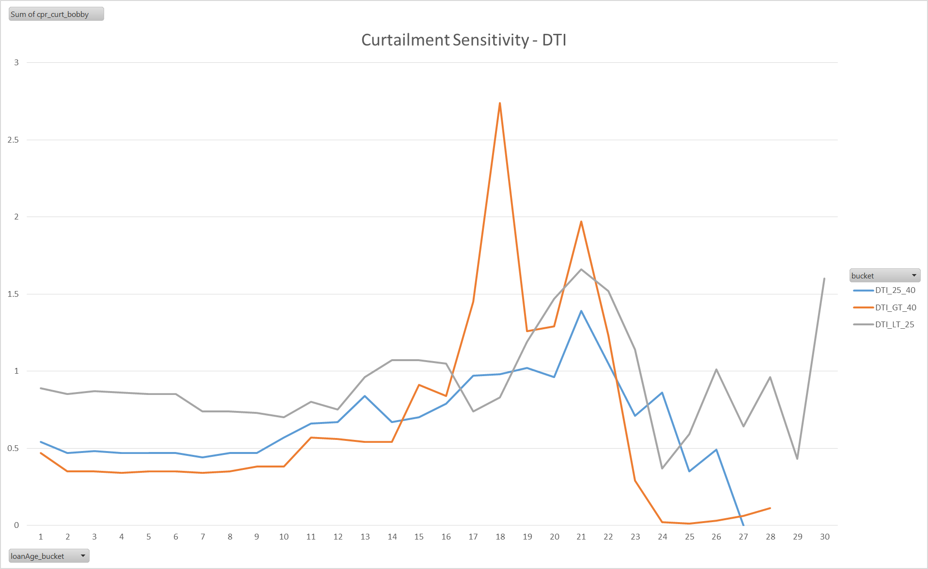
Empirical Observations VII
CPR

Slide 12
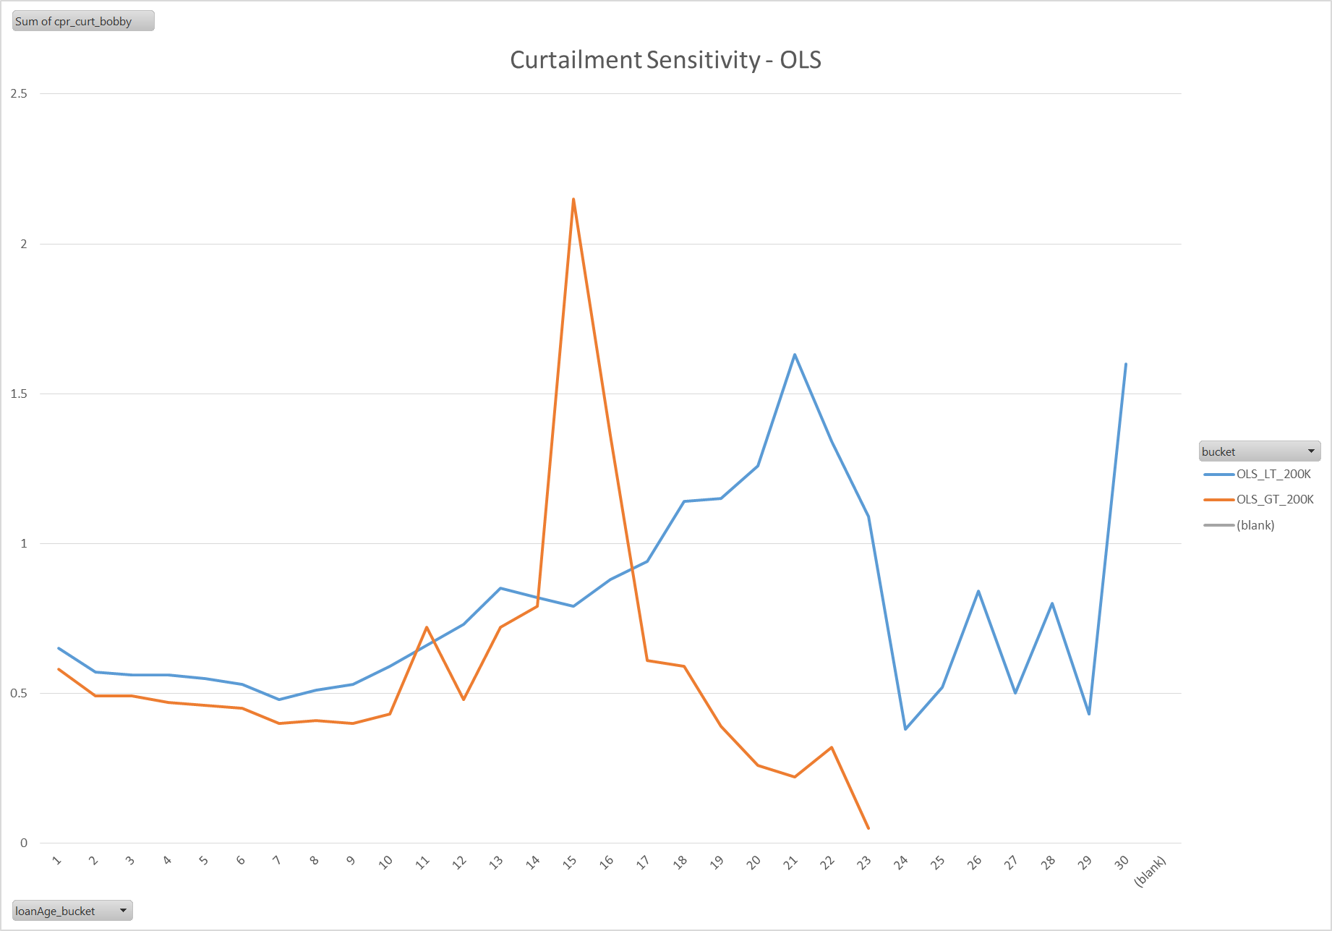
Empirical Observations VIII
CPR

Slide 13
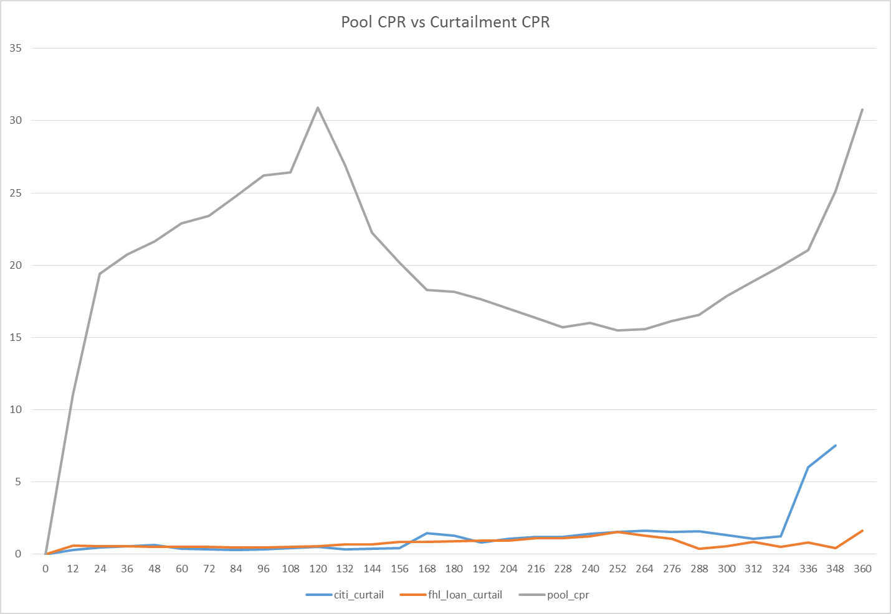
Empirical Observations IX
Final Data
We make use of the Citi Curtailment data along with the FHLMC Curtailment data
Additionally, we pull in the combined FHLMC/FNMA pool level CPR to help capture the full payoffs that we miss from our restrictive definition of curtailment
CPR

Slide 14
Description of Framework
We use R to combine and smooth the curtailment and full payoff data just described into a finalized curtailment vector for fixed-rate 30-year mortgages
Curtailment is assumed to be a monotonically increasing function of WALA
It also shows some sensitivity to FICO and CLTV for the first 15 years. The dependence gradually decays to nothing over the 15 year period
Care is taken to choose monotonically increasing data points to facilitate this assumption
We make use of monotonically increasing spline functions to provide us with a smoothed fit to the data

Slide 15
Results I
Curtailment and Full Payoff curves

Slide 16
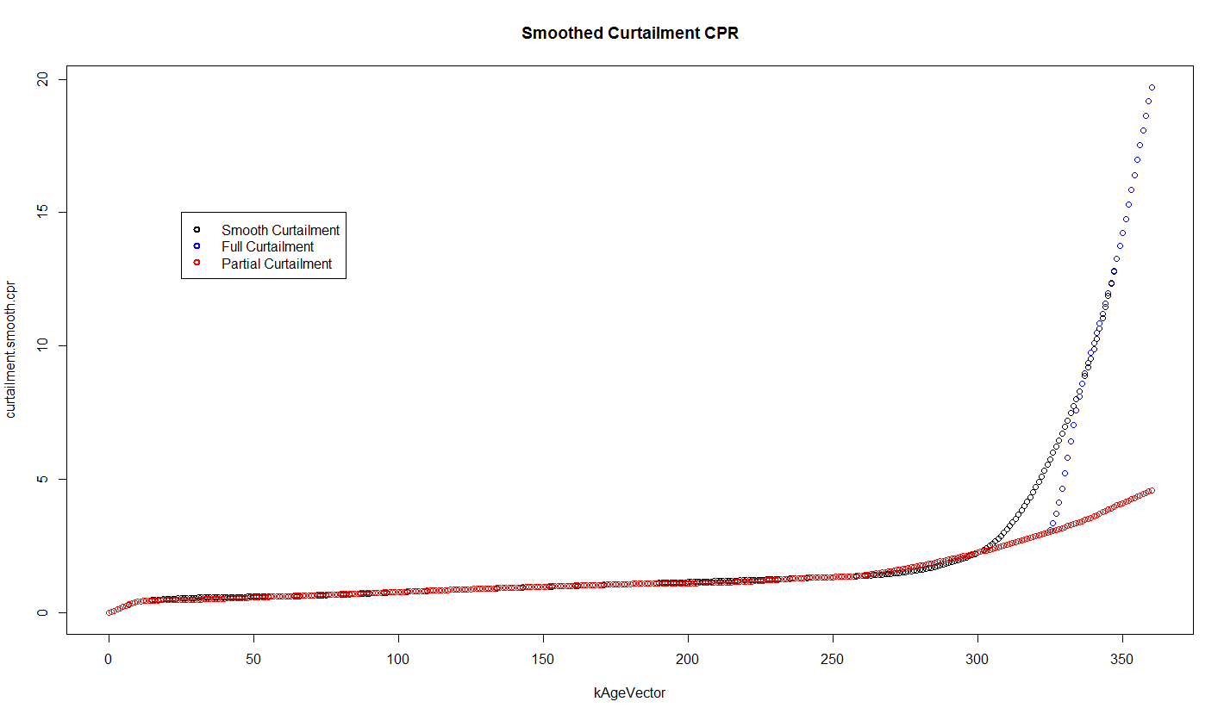
Results II
Smoothed Curtailment and Full Payoff (Full Curtailment = Full Payoff)

Slide 17
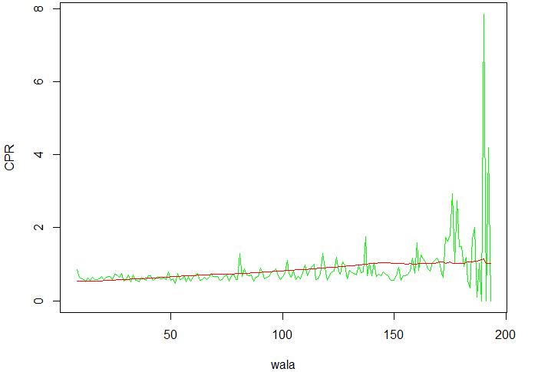
Results III
For the GSE loan level data set, our model shows a close result compare with the actual curtailment numbers.
As of February 2016 factors

Slide 18
Decay Factors
The impacts of FICO and CLTV are not very clear for wala > 180 months. We allow FICO/CLTV multipliers to decay to 1 (zero effect) by 180 months.

Slide 19
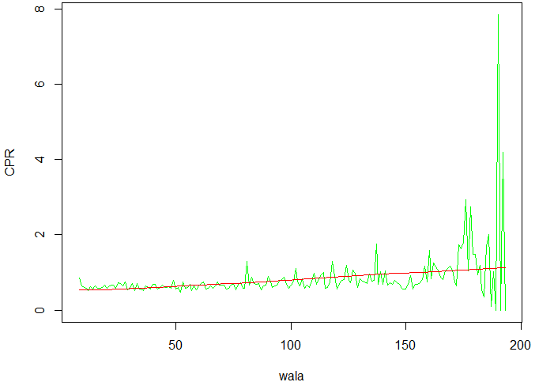
Tracking with Decay factors
Introducing decay factors modestly improves the fits

Slide 20
Total Tracking Error
The combined version (FHL+FNM pools) shows our model is around 2% CPR slower before wala 125 months, 3.5% to 5% CPR faster than Actual after 125 months.

